Slide 1

Genomic Medicine Sweden
Richard Rosenquist Brandell
Karolinska Institutet & Karolinska University Hospital

Slide 2



Precision diagnostics
Healthcare
+
Clinical Genomics nodes
(optimize and adapt for diagnostics)
Genomic Medicine Sweden
(regional implementation of PM)

Slide 3

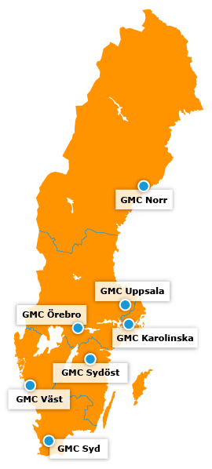
GMS coordinates implementation of precison medicine across Sweden
Clinically focused – bottom-up initiative
National - 7 Genomic Medicine Centers (established at each university hospital)
Harmonised - national standards, guidelines and methods
Cost-effective – coordinated implementation
Innovative – population-based genomic data
Offer patients in all healthcare regions equal access to precision medicine through a nation-wide collaborative effort

Slide 4

National Genomic Platform (NGP)
A separate tentant for each GMC
National resource for healthcare, research and innovation
Realtime analysis & visualization
Links to national registries
Enable secondary use of data once the laws permit
Healthcare
Genomic data
Research
NGP
National Genomic Platform

Slide 6

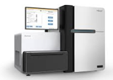

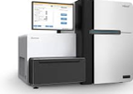




Clinical whole-genome sequencing in rare diseases (3 GMCs)
Healthcare
Healthcare
Deliviery to GMC/SciLifeLab
Whole-genome
sequencing
Automated, secure data processing & QC
Bioinformatic analysis
using custom developed
tools
Clinical interpretation and reporting
Whole-genome sequencing:
Rapid: 5–14 days
Quality assured
Samples to routine dx:
To date: 10 000
Today: 3 000 / year
In 5 years: 15 000 per year
Gold mine for disease gene discovery
  Dramatic clinical impact
6
2021-06-14

Slide 7
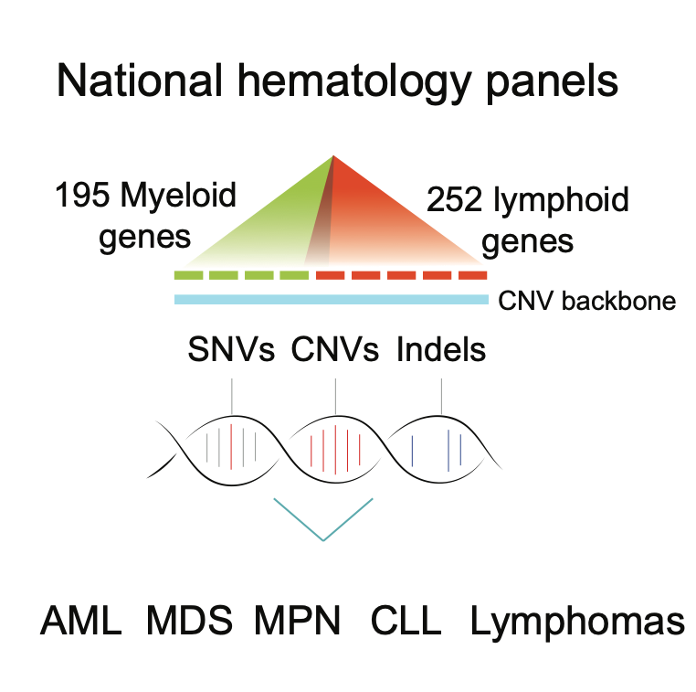
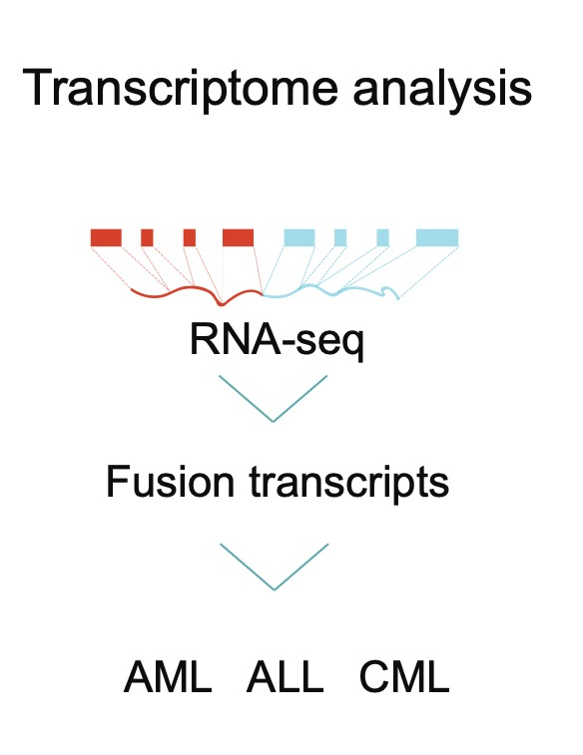
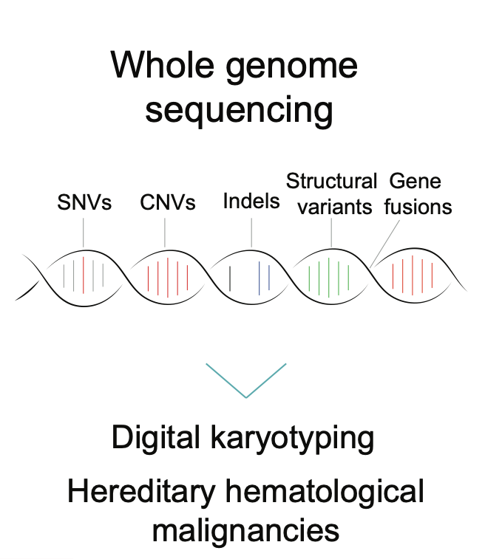
NGS-based diagnostics in hematology
National gene panel for blood cancer is offered at 5 sites
7
2021-06-14

Slide 8
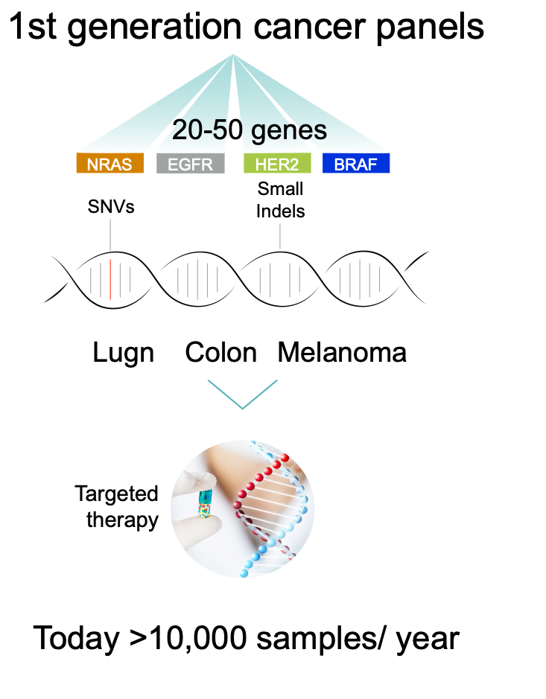
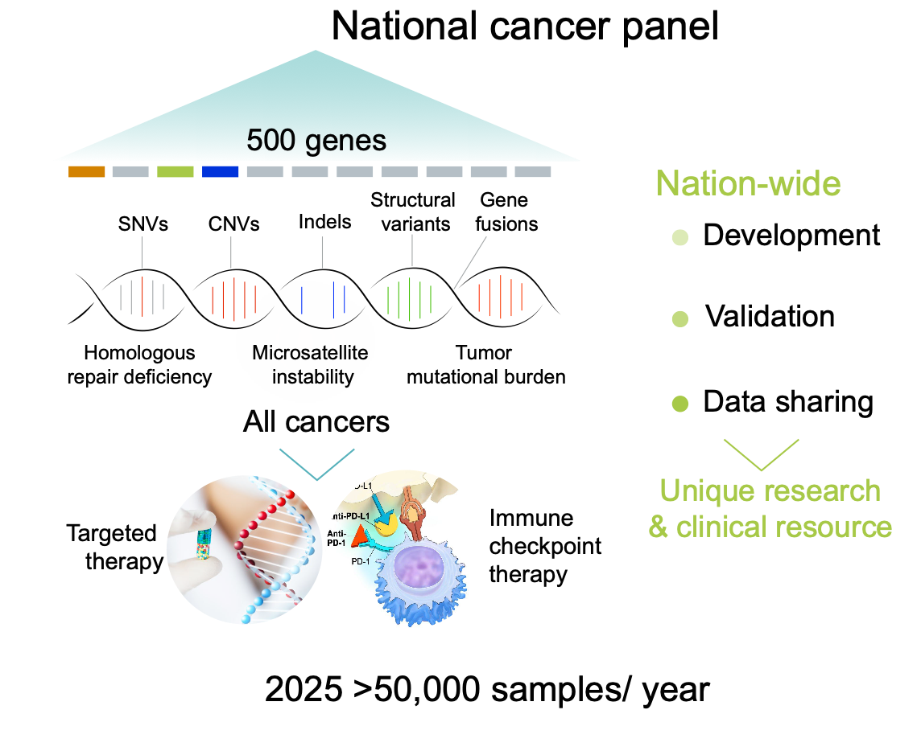
Comprehensive genomic profiling in solid tumors

Slide 9
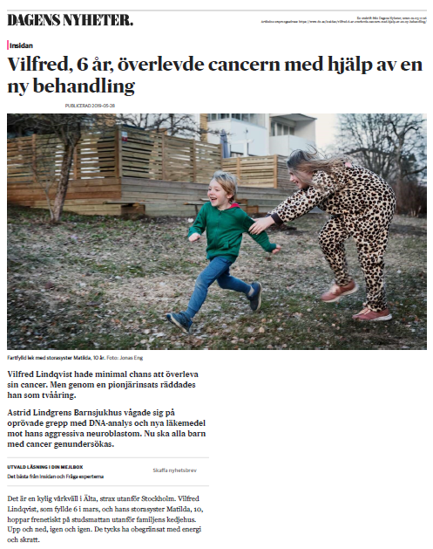



More children with cancer will survive with targeted treatment
National pilot study aims to give all children with cancer access to precision medicine
  Whole-genome sequencing (4 GMCs)
  Targeted therapy
  Genetic predisposition
In collaboration with
With support from
9
2021-06-14

Slide 10


JANUARI 2021
Genomic Medicine Sweden
Broad gene sequencing in healthcare for better diagnostics and equal care for all patients
Established national genome platform and knowledge database
Increased use of genomics and healthcare data for research and innovation
Genomic Medicine Sweden
2021-2030
Increased participation in clinical studies/trials
Primary prevention and early detection of common diseases
>1 000 000 analysis in the next 10 years

