Slide 1
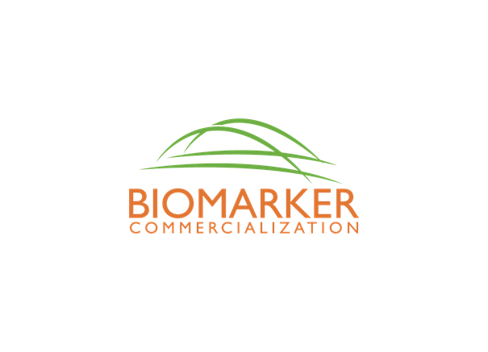
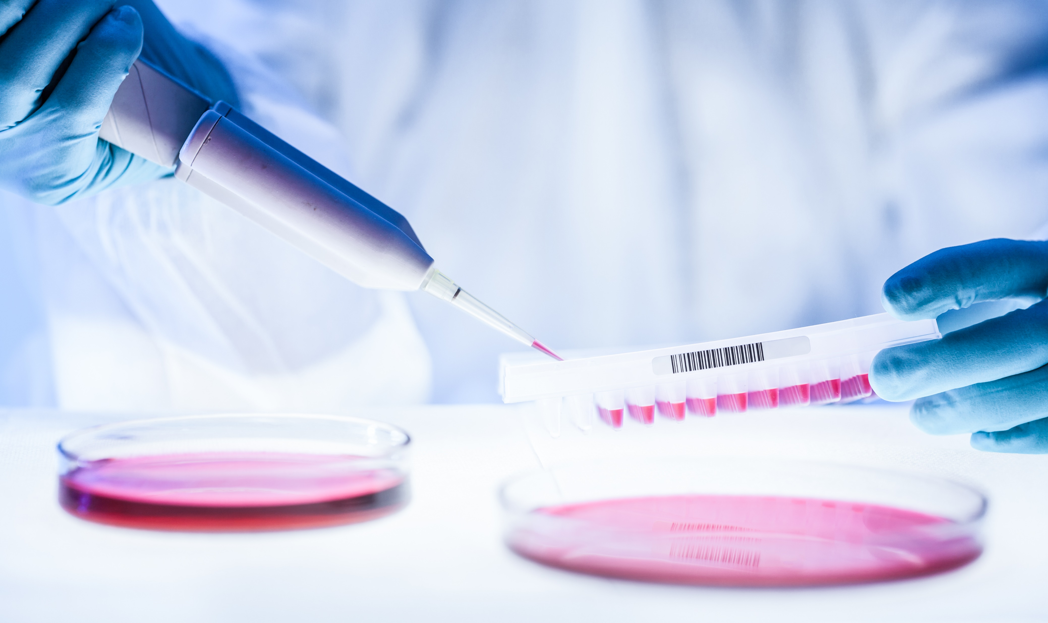
Tools for Biomarker Commercialization
The BIC and BIC BRIDGE Projects
Valerie Daussin Laurent
Aalborg University Hospital
Project Leader BIC and BIC BRIDGE

Slide 2
The Need, the Market and the challenges
Biomarkers can be used for a range of diagnostic applications. Lab test results inform 60% – 70% of all critical clinical decisions, such as whether to admit, discharge and/or initiate therapy for a patient. Biomarkers are also important in the development of new drugs.
Source: marketandmarkets.com , Kalorama information
Despite several 100,000 publications describing candidate biomarkers, the mere fraction of these that ever progress to clinical practice is of 1%
Source: Kern SE. Why your new cancer biomarker may never work….Cancer Res. 72, 6097–6101 (2012).
How do you translate a biomarker discovery from lab to clinical setting?
How to ensure efficient validation phase and generation of valid data?
How to ensure that the researchers have adequate knowledge about the commercialization of biomarkers?
How does a Technolgy Transfer Office (TTO) select the best biomarkers projects for commecialization?
How to provide relevant documentation to industry or investors?
Biomarker definition:
A biological molecule found in blood, other body fluids, or tissues that can be used to follow body processes and diseases in humans and animals (European Medicines Agency).

Slide 3
Why a BIC Guide?
Researchers generally have limited experience with commercialization
Researchers are well aware of the technical requirements for a biomarker development, but regulatory and industrial aspects are not generally their focus
Researchers would benefit of guidance and training in e.g., IPR and regulatory issues, systematic product development and making market and competition analyses
From a company perspective, the development of biomarkers is exclusively based on market and clinical needs as well as cost benefit analyses
Companies are willing to collaborate, but when? Proof of principle? Which kind of validation? What should be included in a proof of concept?
Today there seem to be a development gap between the identification of a biomarker and the clinical validation.

Slide 4
The BIC – Tools
BIC Guide Tool for development and commercialisation from discovery to market launch
A Best Practice Handbook, based on real life experiences
A Review Tool for screening and selection addressed to TTOs
The IVDR Guide: Guidelines for Regulatory Requirements
An Educational Toolbox for research institutions- to use comprehending the process toward commercialisation

Slide 5
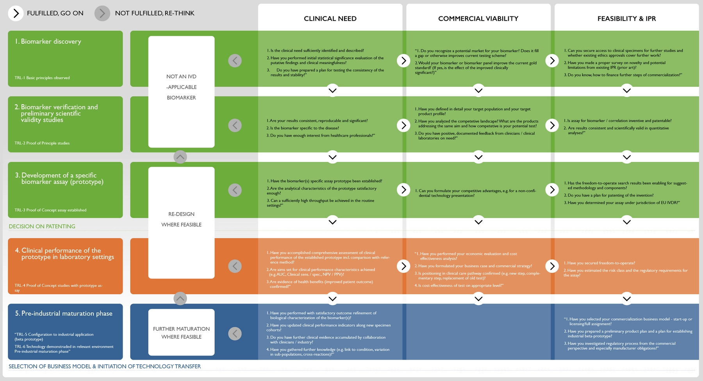
The BIC Guide
7 phases (TRL based)
3 tracks.
A list of tasks
Support documents for specific tasks
Check list and self evaluation tool at the end of each phase
Link to useful material

Slide 6
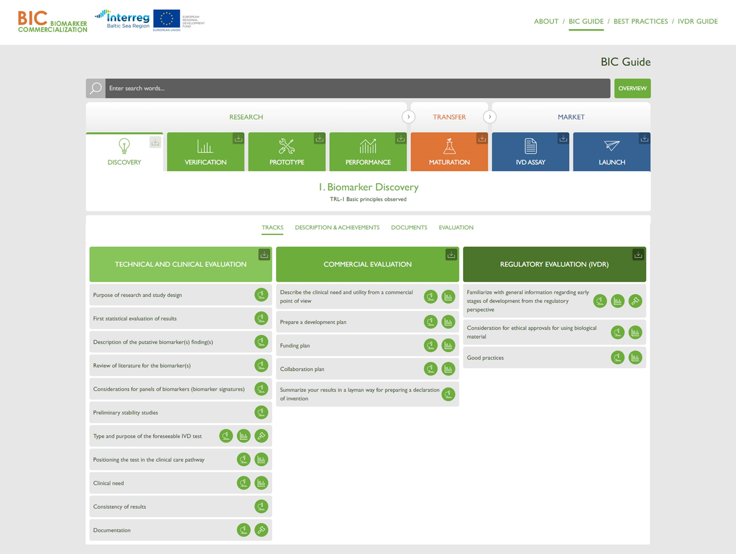
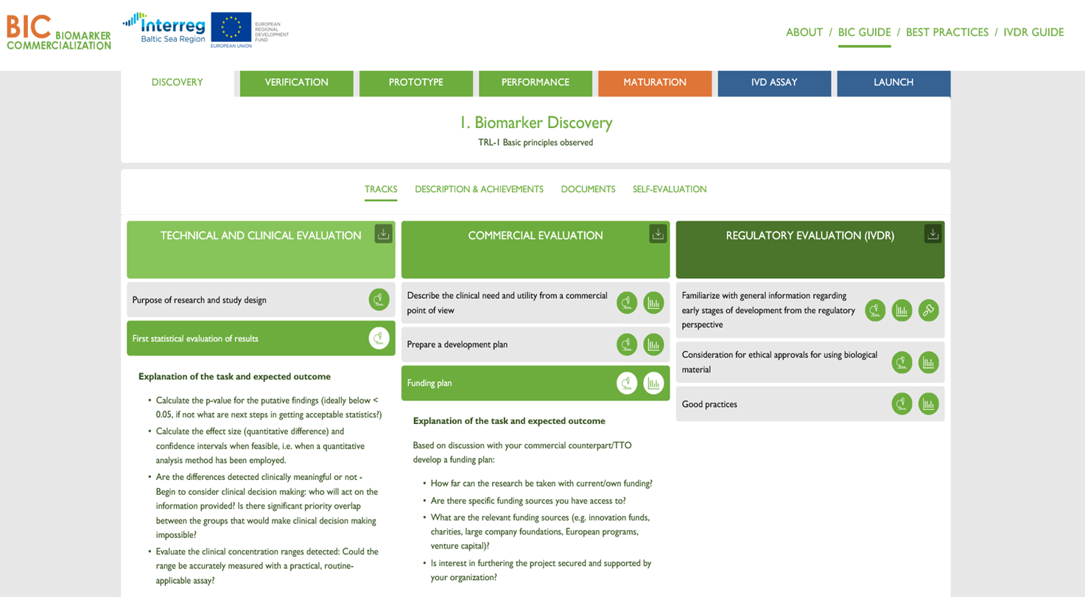

Slide 7
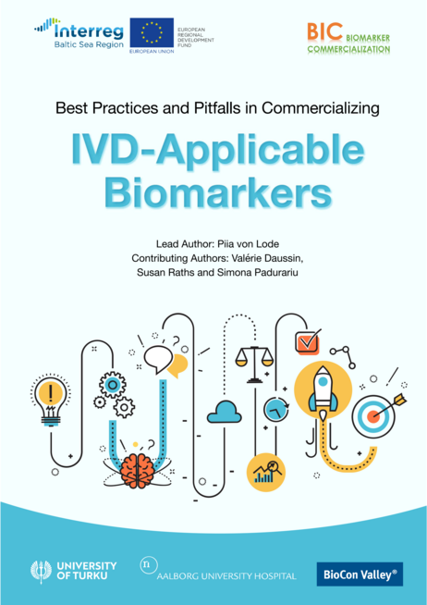
The Best Practices Handbook
CLINICAL IMPACTS OF IVD-APPLICABLE BIOMARKERS
THE IVD-APPLICABLE BIOMARKER PIPELINE
COMMERCIALIZATION ASPECTS
INTELLECTUAL PROPERTY RIGHTS (IPR)
BUSINESS MODELS, AGREEMENTS AND OTHER LEGAL VIEWPOINTS

Slide 8
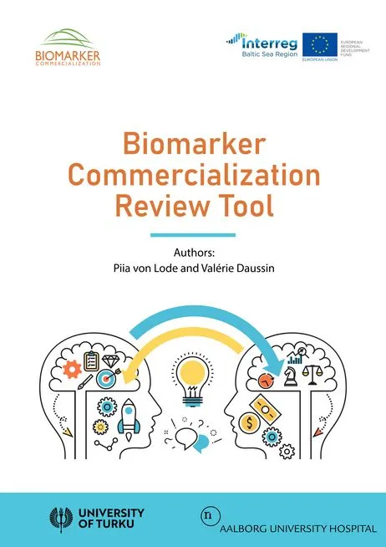
The Review Tool for TTOs
A TOOL TO SELECT THE MOST PROMISING RESULTS
A CHECK LIST FOR VALIDITY PARAMETERS

Slide 9
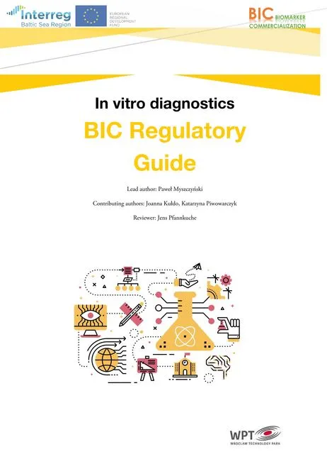
The IVD Regulatory Guide
GUIDING THROUGH THE REGULATORY PROCESS AND EARLY CONSIDERATIONS
HELPING PLANNING DEVELOPMENT IN COMPLIANCE WITH THE IVDR

Slide 10
Project Partners and Funding
A transnational cooperation of 3 research and 5 cluster organizations in the Baltic Sea Region: Denmark (Coordination: Aalborg University Hospital), Estonia, Finland, Germany, Lithuania, Poland
Project budget is EUR 2,55 million and it is co-financed by the European Regional Development Fund through the Interreg Baltic Sea Region Programme with EUR 1,96 million.

Slide 11
biomarker.nu follow us on LinkedIn: - BIC Biomarker Commercialization - now BIC BRIDGE

