Slide 1
RRI in regional healthcare: The CHERRIES approach
Stefan Philipp | ZSI - Centre for Social Innovation
philipp@zsi.at | @_PhilippStefan
This project has received funding from the European Union’s Horizon 2020 research and innovation programme under grant agreement nº 872873.
This document reflects only the author’s view and the Commission is not responsible for any use that may be made of the information it contains.

Slide 2
Context
Pressures on healthcare systems due to ageing populations, chronic diseases, comorbidities etc.
Pressure to reduce costs while improving quality. Thus innovation is a critical factor for organisations within the healthcare system
Healthcare innovations rarely achieve widespread uptake even when there is robust evidence of benefits
Need-orientation, co-creation and RRI approaches could mitigate these issues

Slide 3
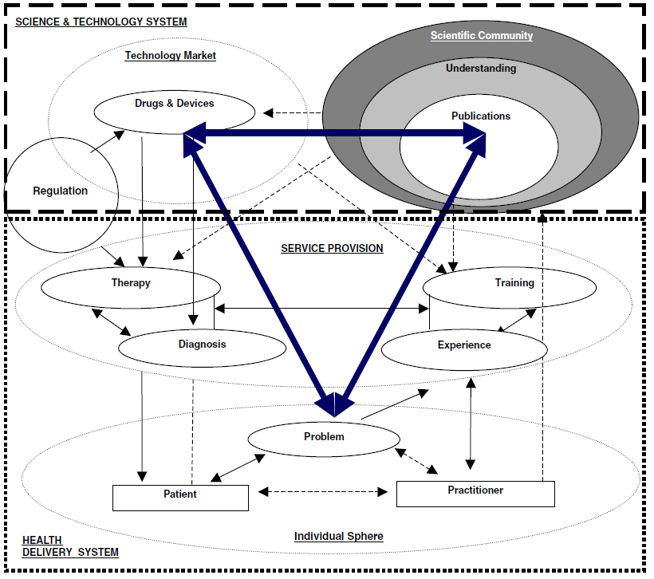
Healthcare innovation systems
Aligning the societal expectations and innovation outcomes requires closer ties between the three spheres.
SGC requires the transformation of a complex systems in a multi-level and multi-scalar setting
Silos within and between organisations inhibit the successful uptake of innovations
Not all innovations are the same – many different processes are covered under “healthcare innovation”
Consoli & Mina, 2009

Slide 4
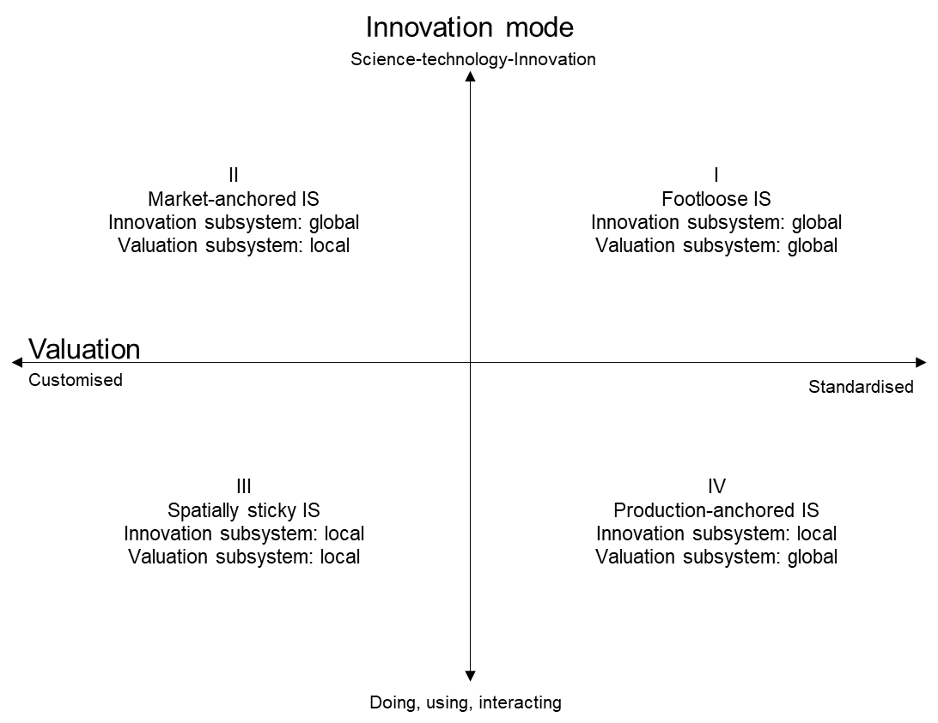
Spatial dimension of healthcare innovation?
Binz and Truffer, 2017

Slide 5
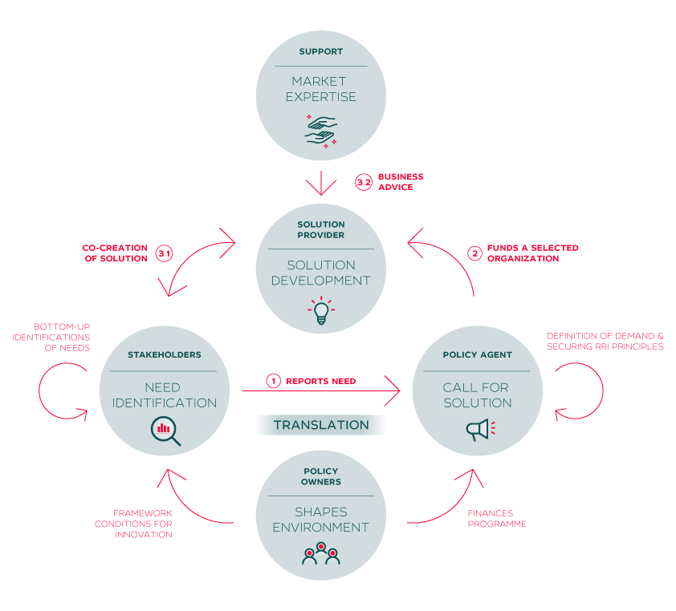
CHERRIES model – the experiment
RRI experiments in healthcare sector based on open-innovation approaches tackling the sector‘s needs
Co-creation approaches for the development of new solutions with at least one pilot action per region
The sectoral R&I systems are being analysed, the experiments are monitored and evaluated
Recommendation for the design of a responsible and demand-oriented regional innovation policy mix

Slide 6
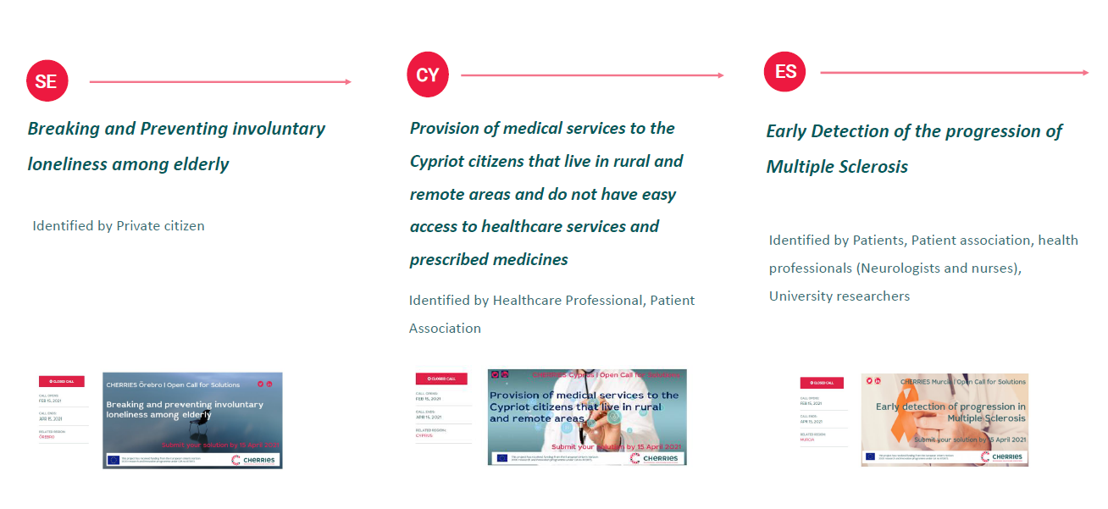
Competitive selection of the solution provider

Slide 7
Competitive selection of the solution provider

Slide 8
Get involved!
The CHERRIES model is currently tested in three regions.
Our goal is to create a community of al least 3 more regions who will benefit from personalised support to implement the CHERRIES model and learnings in their own territories, leveraging their own territorial resources.
The Call for Mirror Regions is launched in fall!
Follow us for updates!
@CHERRIES_eu
Cherries-eu
Newsletter

Slide 9
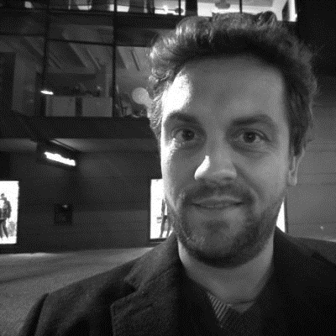
Questions?
STEFAN PHILIPP
philipp@zsi.at

